Slide 1


ExoPredict
Mandeep
Patrick
Iarsolav
Amrit

Slide 2
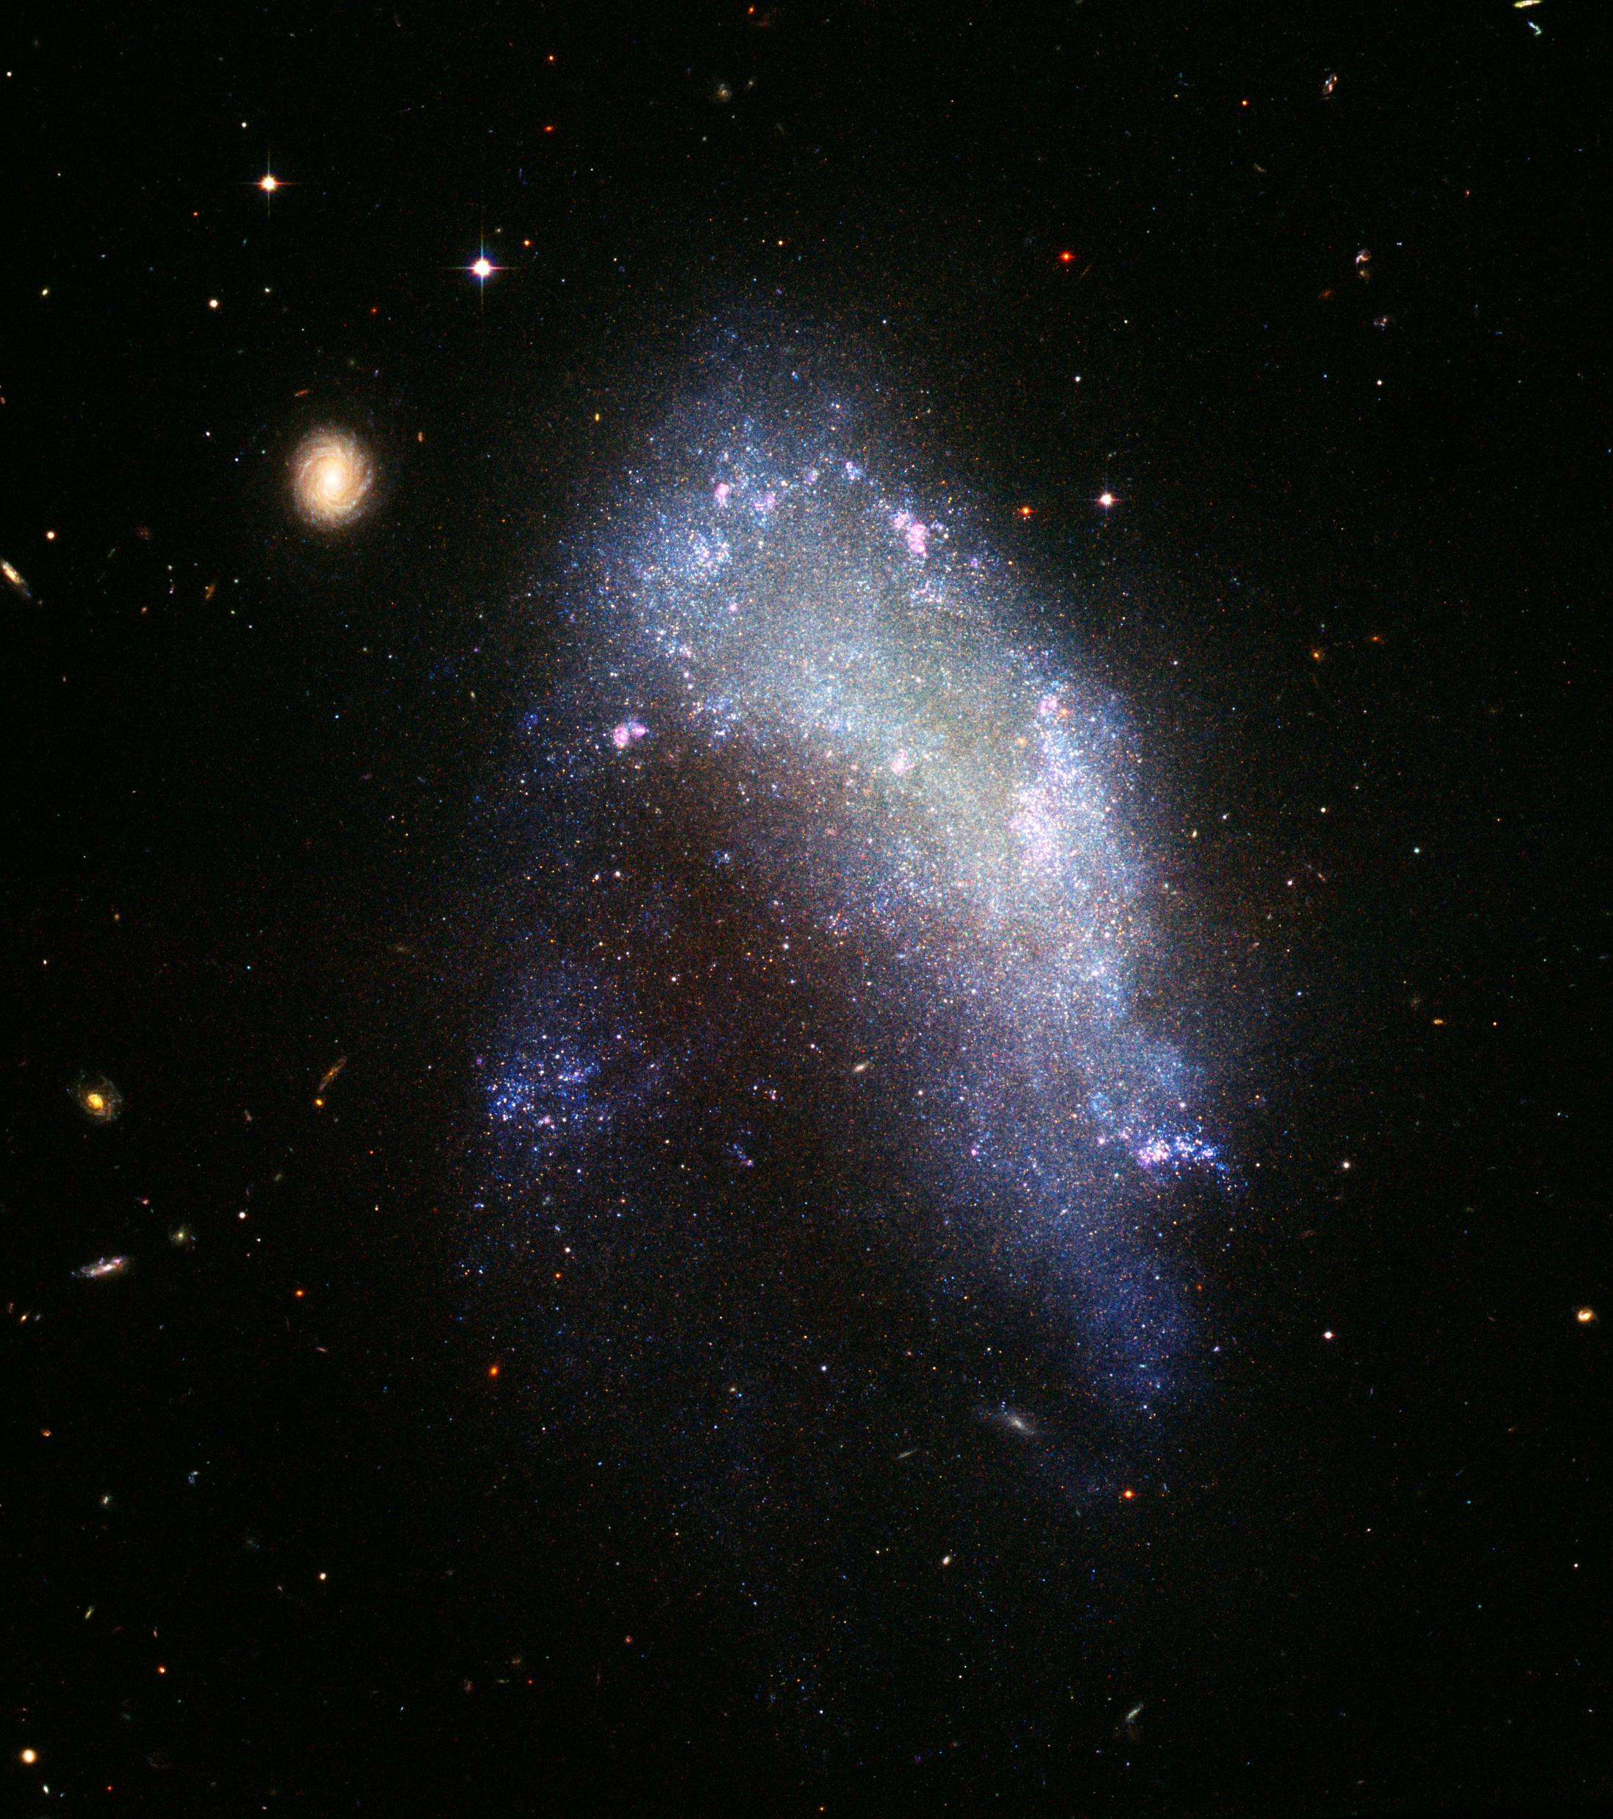

ExoPredict
Classifying and Predicting
Exoplanet Characteristics
Mandeep
Amrit
Iarsolav
Patrick
This Photo by Unknown Author is licensed under CC BY-SA

Slide 3


What are Exoplanets
HOME
This Photo by Unknown Author is licensed under CC BY-SA

Slide 4
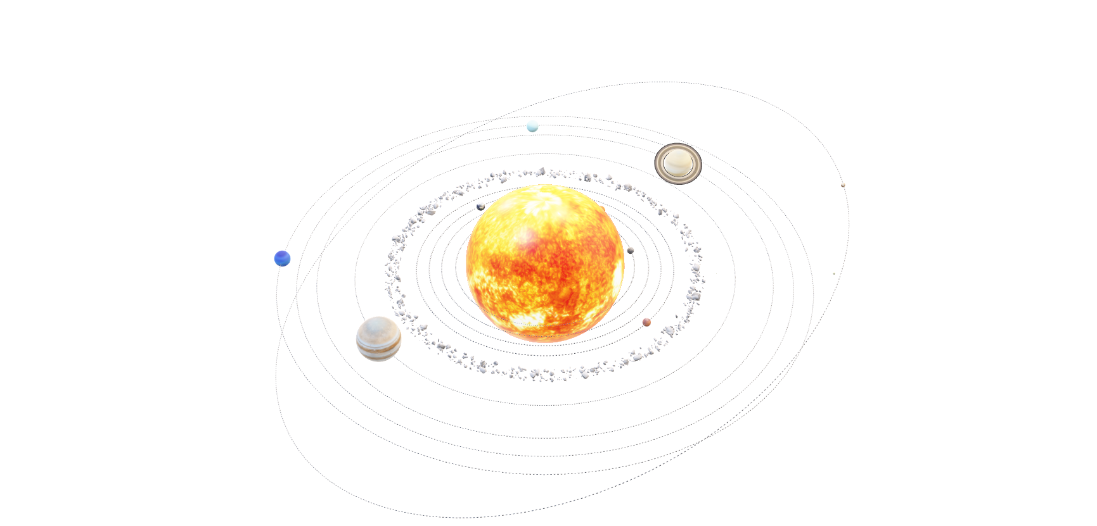
What are Exoplanets
Milky Way
This Photo by Unknown Author is licensed under CC BY-SA

Slide 5
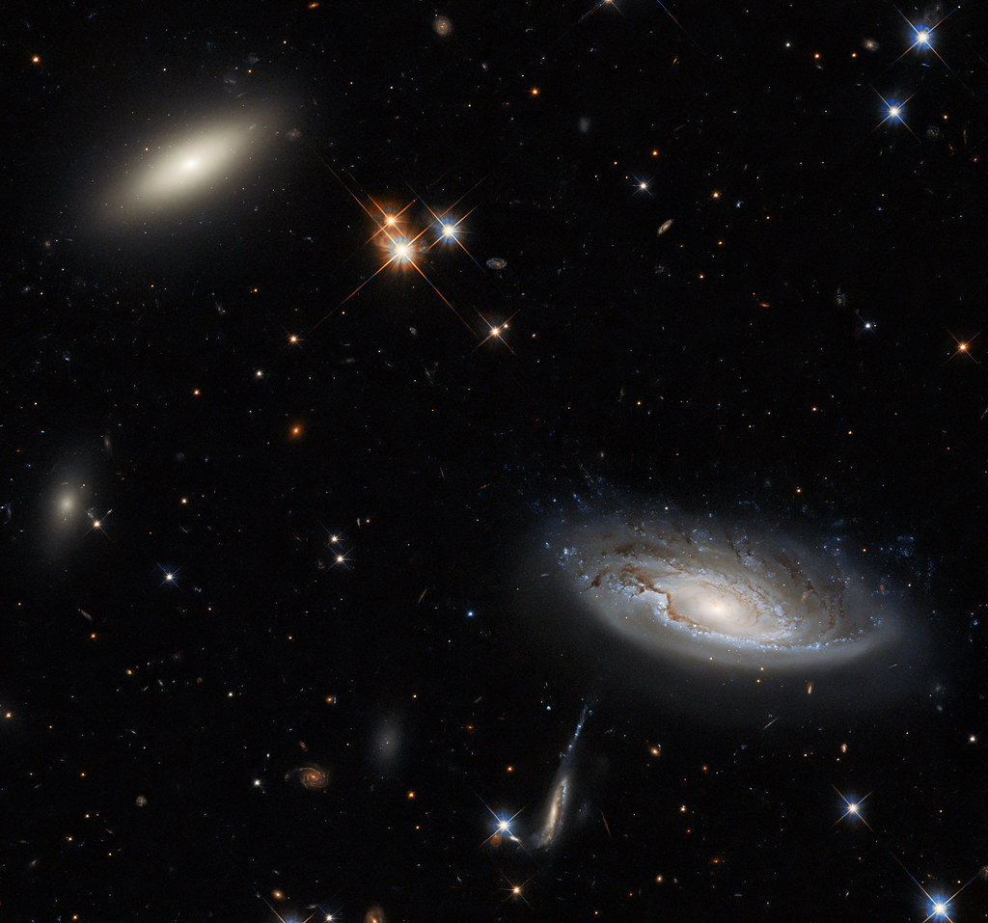
Introduction
Australia is going to have a privilege to host the 76th International Astronautical Congress conference, scheduled to be held in Sydney in 2025, inspiring catalyst for exploration in space science and technology.
By utilizing advanced analytics that we learned throughout our course, we aim to contribute a data-driven perspective to the exciting developments surrounding this prestigious event.

Slide 6
Dataset Info
The data was collected from NASA EXOPLANET ARCHIVE . We selected the stellar dataset. However there are many more sets available on their website for public use (Ethical Considerations). Further information about the datasets can be procured from :
https://exoplanetarchive.ipac.caltech.edu/cgi-bin/TblView/nph-tblView?app=ExoTbls&config=PS&c[…]_flag%3E0&constraint=disc_method%20like%20%27tran%27

Slide 7

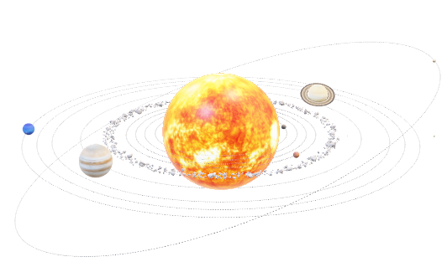
Overview
In this presentation, we delve into a comprehensive dataset connected to the conference, leveraging data analytics to uncover valuable insights.

Slide 8

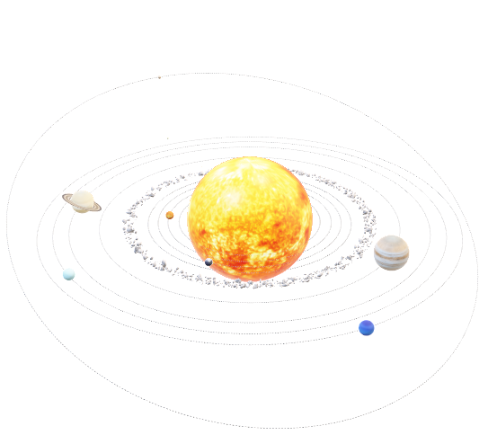
Data Analysis
We have chosen following questions for our data analysis:
Planet’s habitability
Stellar orbital Impact on planet’s temperature
Categorisation of planets (Gas Giant or Rocky surface)
Which facility discovered most exoplanets
What methods are more acceptable than others to discover the exoplanets and why?
Comparing stars and exoplanets by how far their parameters are from each other
Trying to predict number of exoplanets per star

Slide 9

ETL Process
ETL process and Data Analysis with Python libraries, PySpark, Pandas, seaborn, matplotlib
Extract: Load exoplanet data from a CSV file.
Transform: Clean and preprocess the data.
Load: Save the processed dataset for further analysis.

Slide 10
How do planetary characteristics influence the likelihood of being in the habitable zone? (Mandeep)
Semi-Major Axis (AU) and Equilibrium Temperature determine the planets’s habitability.
Habitable-
Semi-Major Axis (AU) between 0.38 to 1.5 AU
Equilibrium Temperature between 200K to 320K
Non-habitable – outside the range above

Slide 11
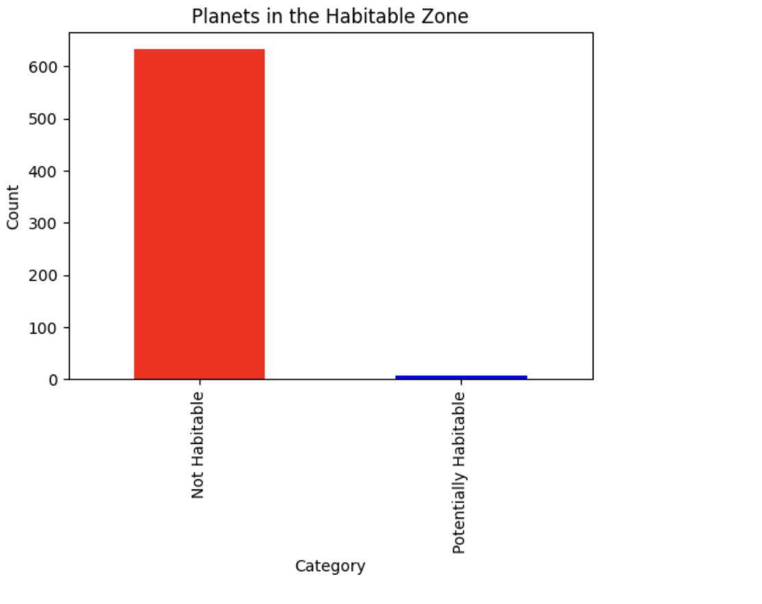
How do planetary characteristics influence the likelihood of being in the habitable zone? (Mandeep)
Total 634 Planets habitable

Slide 12
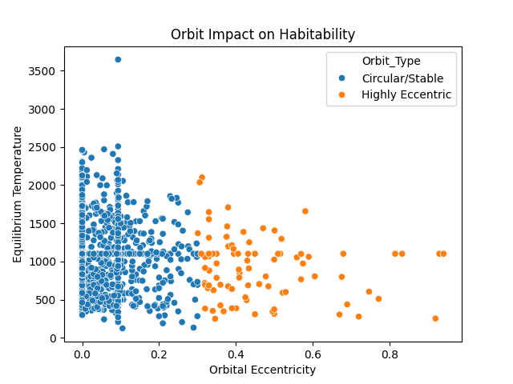

2. How does a planet’s orbit impact its temperature and potential habitability?(Mandeep)
Highly eccentric orbits cause significant temperature fluctuations

Slide 13
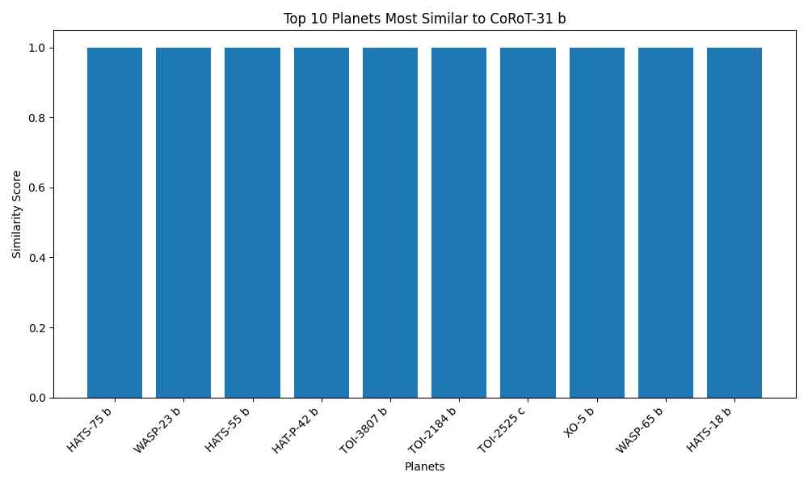

Comparing planets by how far their parameters are from each other(Iaroslav)

Slide 14
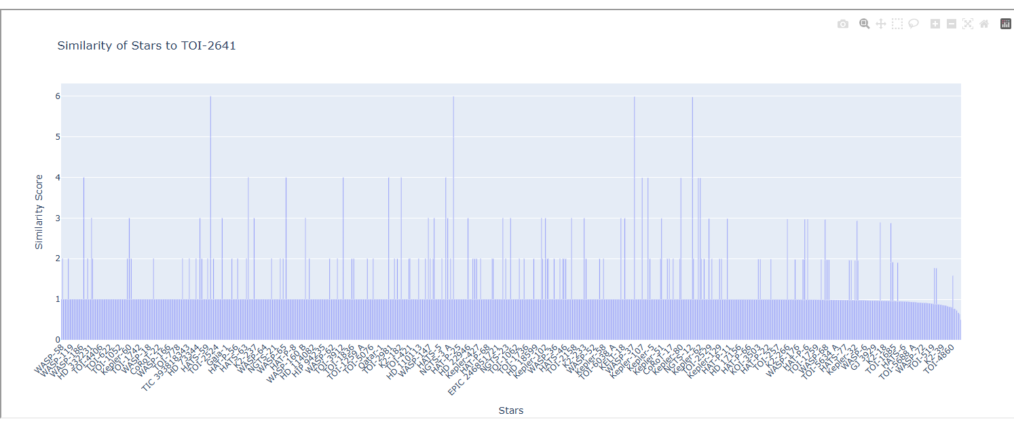
Comparing stars by how far their parameters are from each other (star temperature, star radius relative to Sun, star mass relative to Sun)(Iaroslav)

Slide 15
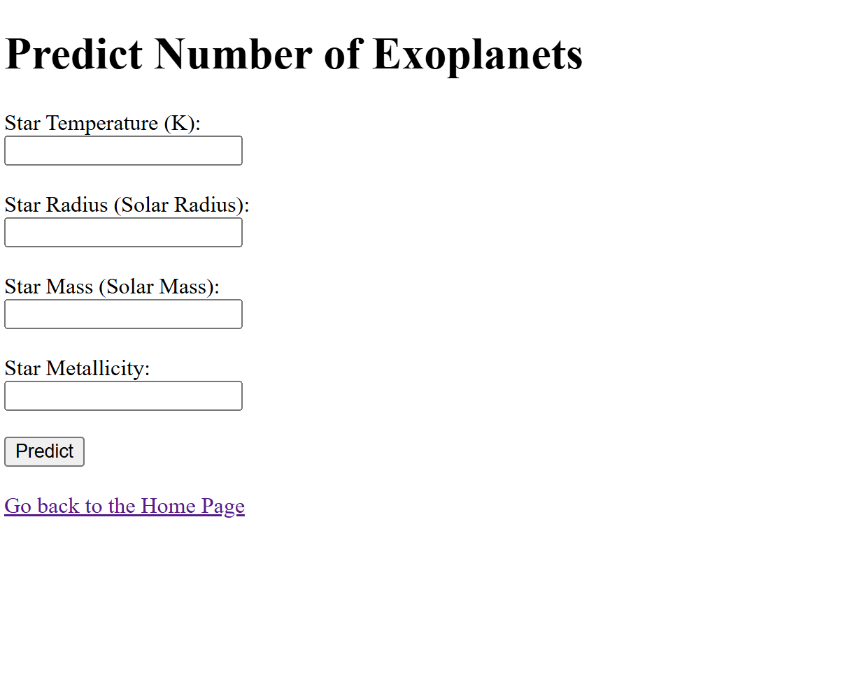

Machine Learning- API and Web Applications

Slide 16
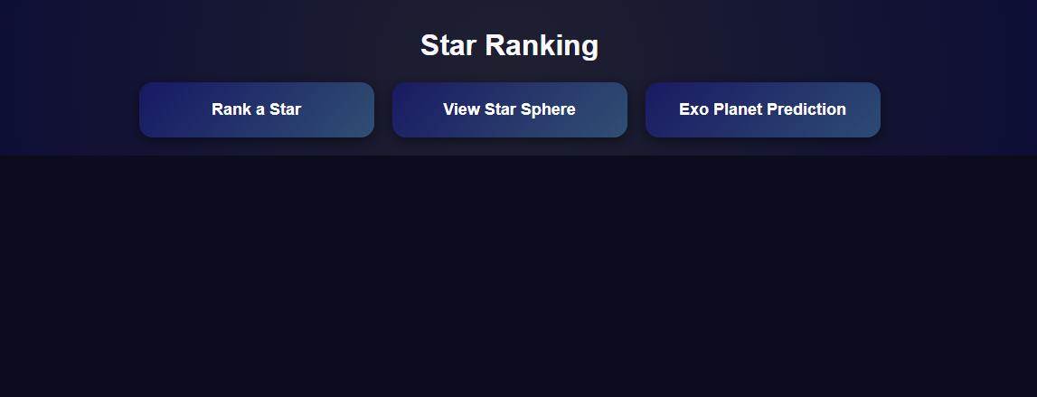
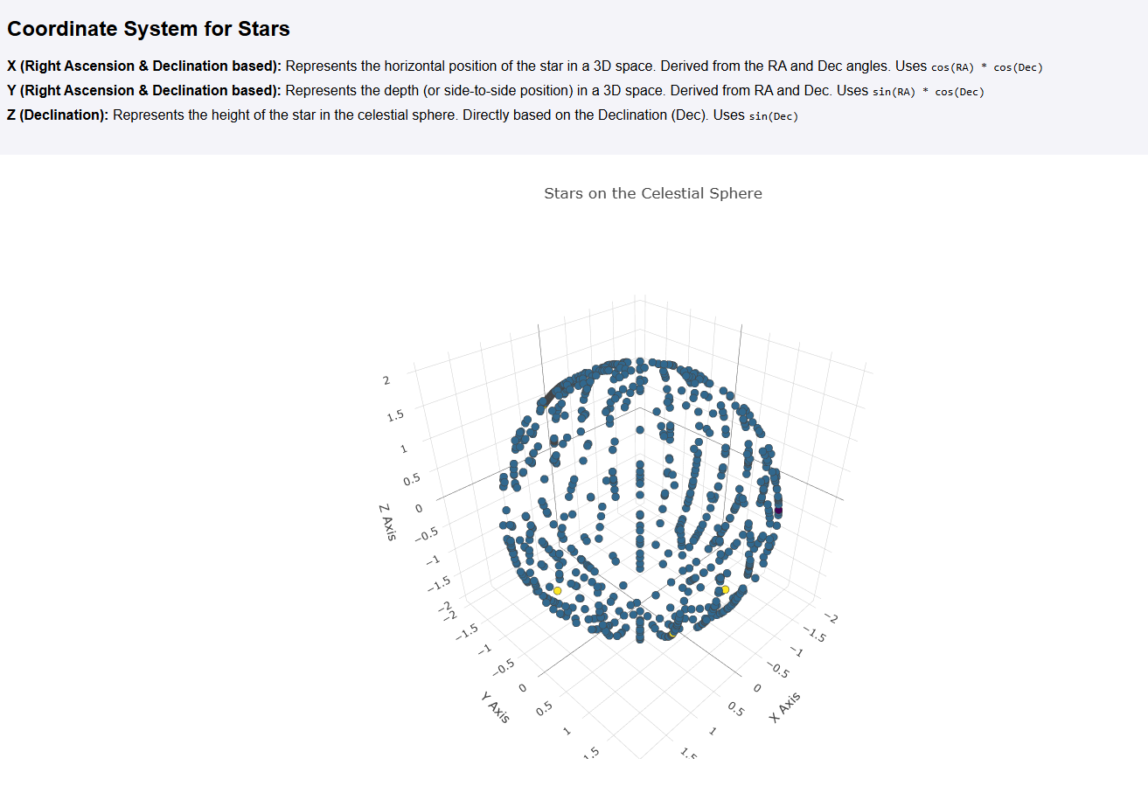
Machine Learning- API and Web Applications
A basic Neural Network was trained to predict a possible number of exo planets for a star with certain parameters such as star temperature, star radius relative to Sun, star mass relative to Sun, star metallicity.

Slide 17
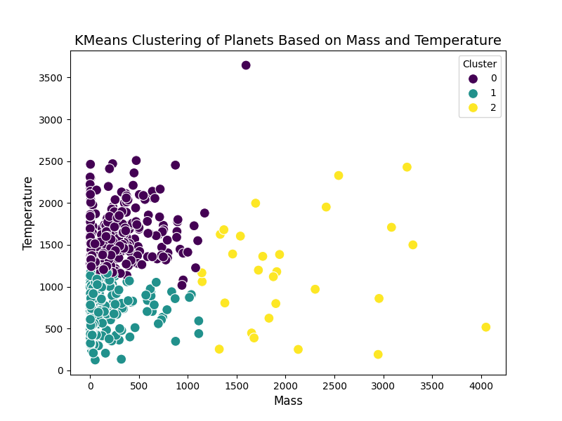
Can we identify groups of similar exoplanets? (Patrick)

Slide 18
Can we identify groups of similar exoplanets?
The K-Means algorithm clusters exoplanets based on mass and temperature into three groups (0, 1, 2). Cluster 2 contains most planets, including Kepler-138 c and HD 136352 c, with moderate mass (2.3–11.24) and temperatures (410–784K). Cluster 0 includes massive, hotter planets like TOI-3819 b (230.11–371.85 mass, 1028–1890K). This analysis highlights mass and temperature as key factors in exoplanet classification.

Slide 19
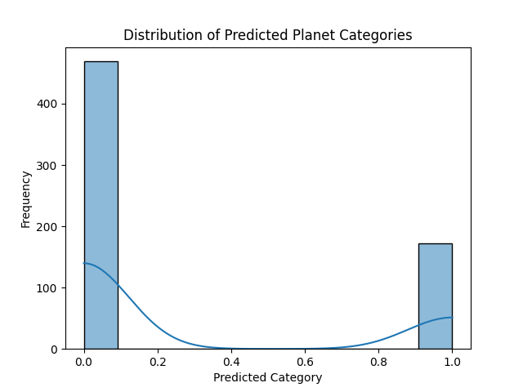
Can we classify planets into different categories (e.g., rocky planets, gas giants) based on their properties?

Slide 20
Question 2: Can we classify planets into different categories (e.g., rocky planets, gas giants) based on their properties?
Number of Rocky Planets: 171
Number of Gas Giants: 470

Slide 21
Machine Learning Optimization
Techniques implemented for Optimization: 1. Increased Network Depth and Width 2. Batch Normalization 3. Dropout Regularization 4. Early Stopping 5. Learning Rate Reduction 6. Extended Training Epochs 7. Larger Batch Size 8. Performance Tracking

Slide 22

What are the most and least popular discovery methods and why?(Amrit)
Total discovery methods:
Mostly used - Transit
Rarely used - Transit Timing Variations

Slide 23
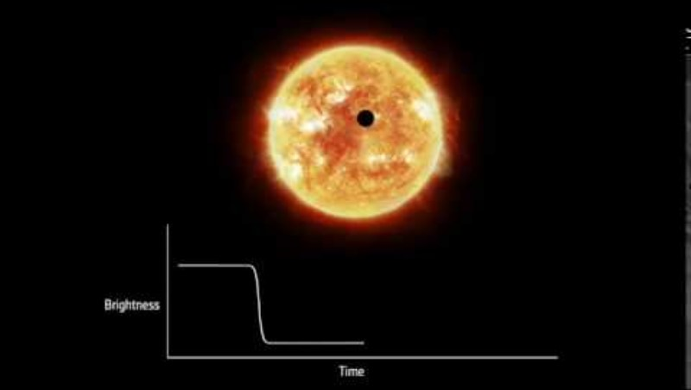

What are the most and least popular discovery methods and why?
Transit-
1102 discoveries
Measure the dimming of a star's light as a planet passes in front of it.

Slide 24
What are the most and least popular discovery methods and why?
Transit-
Benefit - High Accuracy as it measures dips in a star’s brightness.
Drawback - Requires precise alignment

Slide 25
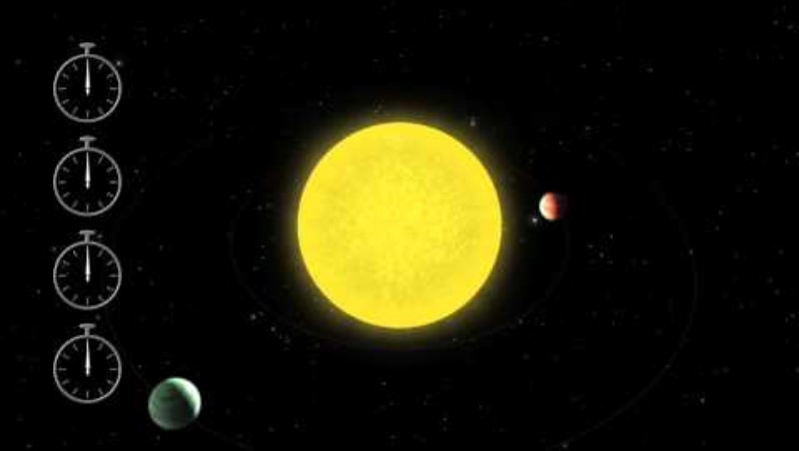

What are the most and least popular discovery methods and why?
Transit Timing Variations –
(TTVs) are changes in the timing of an exoplanet's transit across its star

Slide 26
What are the most and least popular discovery methods and why?
Transit Timing Variations –
Benefit- Helps identify additional exoplanets in a system by analyzing gravitational interactions between planets
Drawback-Less reliable and requires long observation periods

Slide 27
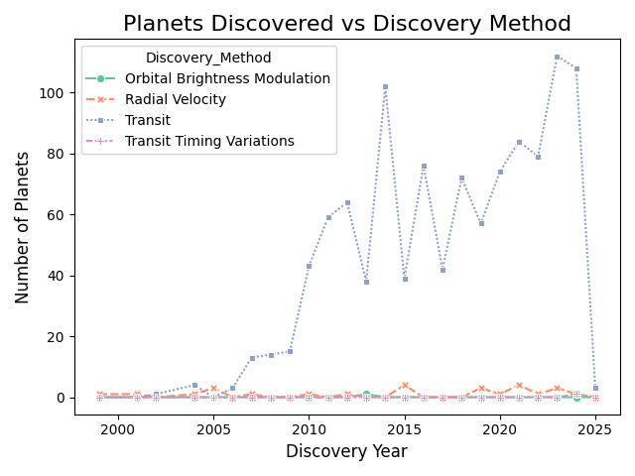
What are the most and least popular discovery methods and why?

Slide 28
The effects of distance variation of a planet host from its exoplanets on its' temperature and luminosity?
Hypothesis
The Exoplanets luminosity and temperature is perpetually inverse to its relative stellar distance.

Slide 29
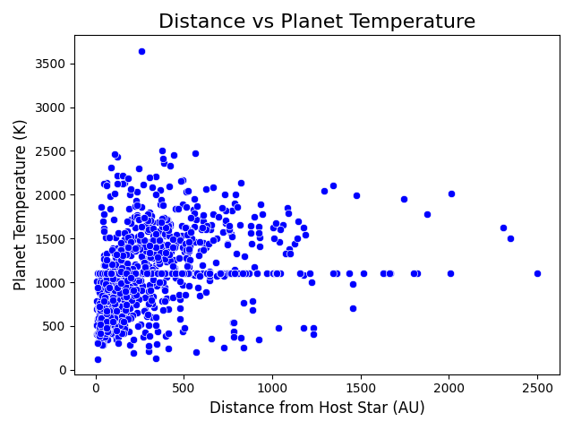
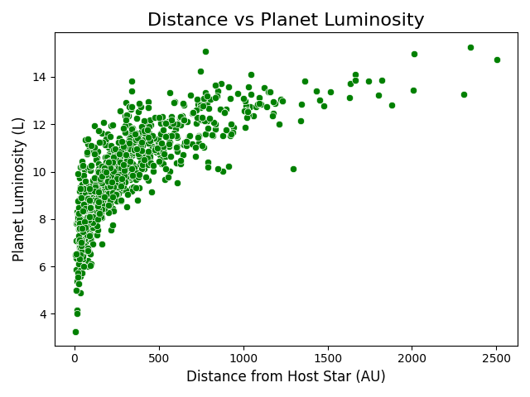

The effects of distance variation of a planet host from its exoplanets on its' temperature and luminosity?

Slide 30
What are the most and least popular discovery methods and why?
Hypothesis- True
The analysis shows the hypothesis was true . This analysis is further supported by the inverse square law of radiation.

Slide 31
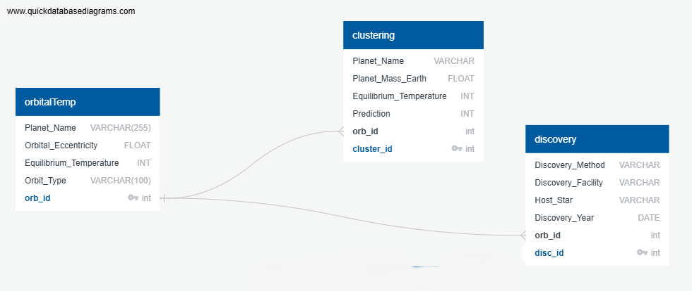
Postgres SQL

Slide 32
Key Findings
Total 634 Planets were found habitable
We are surrounded by more Gas Giants than Rocky Planets
Transit method is widely used to discover the new exoplanets
Planets closer to their host are highly luminous and hot
The mass of the star significantly impacts on the number of exoplanets

Slide 33
Recommendations
Higher resolution datasets
Refining models
Incorporating additional planetary characteristics

Slide 34
Conclusion
The ExoPredict project successfully analyzed exoplanetary data to classify and predict exoplanet characteristics using machine learning and clustering algorithms. By leveraging NASA's exoplanet dataset, our team explored planetary properties, habitability, and discovery trends.

Slide 35

Questions?

Slide 36

Thank you!

